Slide 1

Fundamental Knowledge on Software Engineering
Lecture 2

Slide 2
Topics covered
Professional software development
What is meant by software engineering.
Software engineering ethics
A brief introduction to ethical issues that affect software engineering.
Case studies
An introduction to three/four examples that are used in later chapters in the slides.

Slide 3
Frequently asked question : Software Engineering
Question | Answer
What is software? | Computer programs and associated documentation. Software products may be developed for a particular customer or may be developed for a general market.
What are the attributes of good software? | Good software should deliver the required functionality and performance to the user and should be maintainable, dependable and usable.
What is software engineering? | Software engineering is an engineering discipline that is concerned with all aspects of software production.
What are the fundamental software engineering activities? | Software specification, software development, software validation and software evolution.
What is the difference between software engineering and computer science? | Computer science focuses on theory and fundamentals; software engineering is concerned with the practicalities of developing and delivering useful software.
What is the difference between software engineering and system engineering? | System engineering is concerned with all aspects of computer-based systems development including hardware, software and process engineering. Software engineering is part of this more general process.
Notes:
Specification: detail description
Evolution: gradual development

Slide 4
Frequently asked question : Software Engineering
Question | Answer
What are the key challenges facing software engineering? | Coping with increasing diversity, demands for reduced delivery times and developing trustworthy software.
What are the costs of software engineering? | Roughly 60% of software costs are development costs, 40% are testing costs. For custom software, evolution costs often exceed development costs.
What are the best software engineering techniques and methods? | While all software projects have to be professionally managed and developed, different techniques are appropriate for different types of system. For example, games should always be developed using a series of prototypes whereas safety critical control systems require a complete and analyzable specification to be developed. You can’t, therefore, say that one method is better than another.
What differences has the web made to software engineering? | The web has led to the availability of software services and the possibility of developing highly distributed service-based systems. Web-based systems development has led to important advances in programming languages and software reuse.

Slide 5
Essential attributes of good software
Product characteristic | Description
Maintainability | Software should be written in such a way so that it can evolve to meet the changing needs of customers. This is a critical attribute because software change is an inevitable requirement of a changing business environment.
Dependability and security | Software dependability includes a range of characteristics including reliability, security and safety. Dependable software should not cause physical or economic damage in the event of system failure. Malicious users should not be able to access or damage the system.
Efficiency | Software should not make wasteful use of system resources such as memory and processor cycles. Efficiency therefore includes responsiveness, processing time, memory utilisation, etc.
Acceptability | Software must be acceptable to the type of users for which it is designed. This means that it must be understandable, usable and compatible with other systems that they use.
Notes:
Inevitable: that I can't avoid

Slide 6
Software process activities
Software specification, where customers and engineers define the software that is to be produced and the restrictions on its operation.
Software development, where the software is designed and programmed.
Software validation, where the software is checked to ensure that it is what the customer requires.
Software evolution, where the software is modified to reflect changing customer and market requirements.

Slide 7
General issues that affect most software
Heterogeneity
Increasingly, systems are required to operate as distributed systems across networks that include different types of computer and mobile devices.
Business and social change
Business and society are changing incredibly quickly as emerging economies develop and new technologies become available. They need to be able to change their existing software and to rapidly develop new software.
Security and trust
As software is intertwined with all aspects of our lives, it is essential that we can trust that software.

Slide 8
Software engineering diversity ####02
There are many different types of software system and there is no universal set of software techniques that is applicable to all of these.
The software engineering methods and tools used depend on the type of application being developed, the requirements of the customer and the background of the development team.

Slide 9
Application types
Stand-alone applications
These are application systems that run on a local computer, such as a PC. They include all necessary functionality and do not need to be connected to a network.
Interactive transaction-based applications
Applications that execute on a remote computer and are accessed by users from their own PCs or terminals. These include web applications such as e-commerce applications.
Embedded control systems
These are software control systems that control and manage hardware devices.Numerically, there are probably more embedded systems than any other type of system.

Slide 10
Application types
Batch processing systems
These are business systems that are designed to process data in large batches. They process large numbers of individual inputs to create corresponding outputs.
Entertainment systems
These are systems that are primarily for personal use and which are intended to entertain the user.
Systems for modelling and simulation
These are systems that are developed by scientists and engineers to model physical processes or situations, which include many, separate, interacting objects.

Slide 11
Application types
Data collection systems
These are systems that collect data from their environment using a set of sensors and send that data to other systems for processing.
Systems of systems
These are systems that are composed of a number of other software systems.

Slide 12

E-Commerce

Slide 13
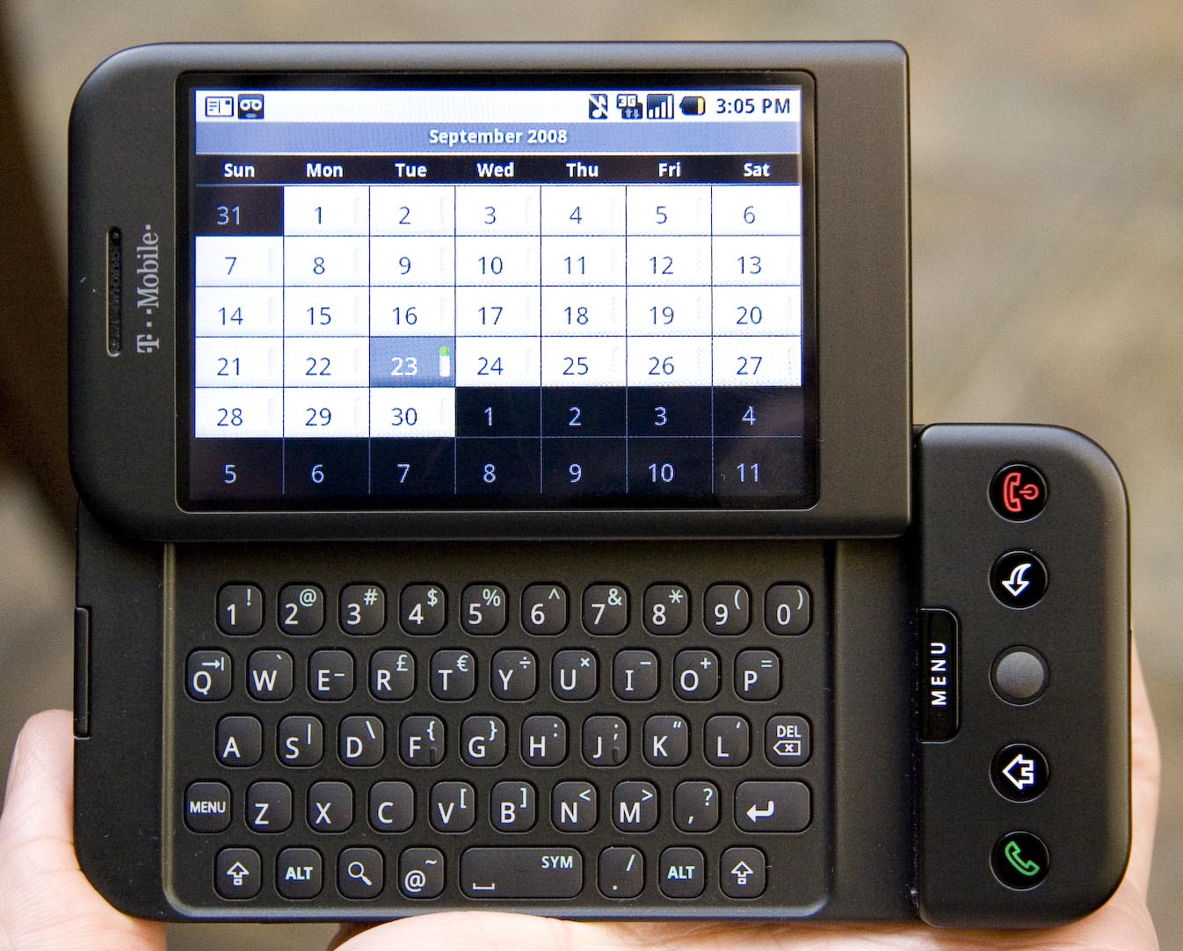
Embedded control systems

Slide 14
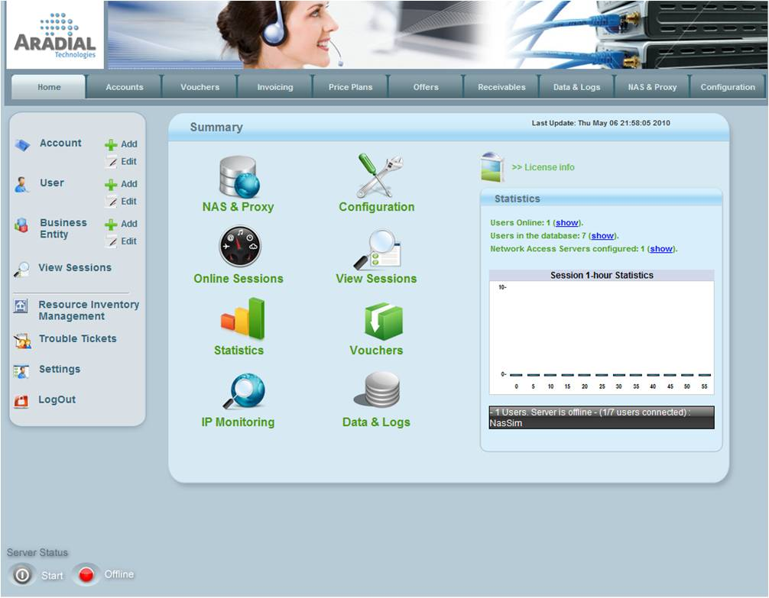
Batch processing systems

Slide 15
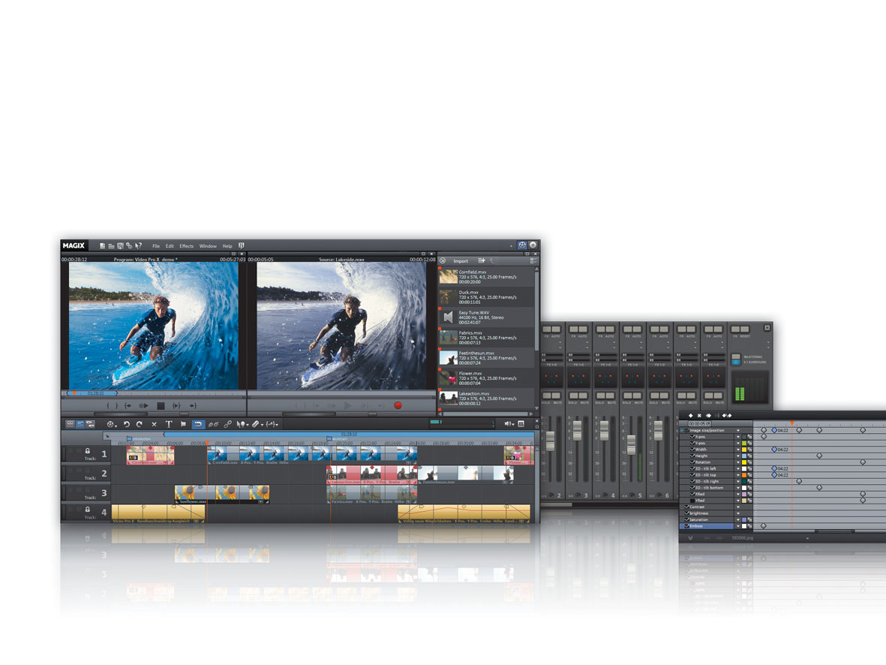
Entertainment systems

Slide 16
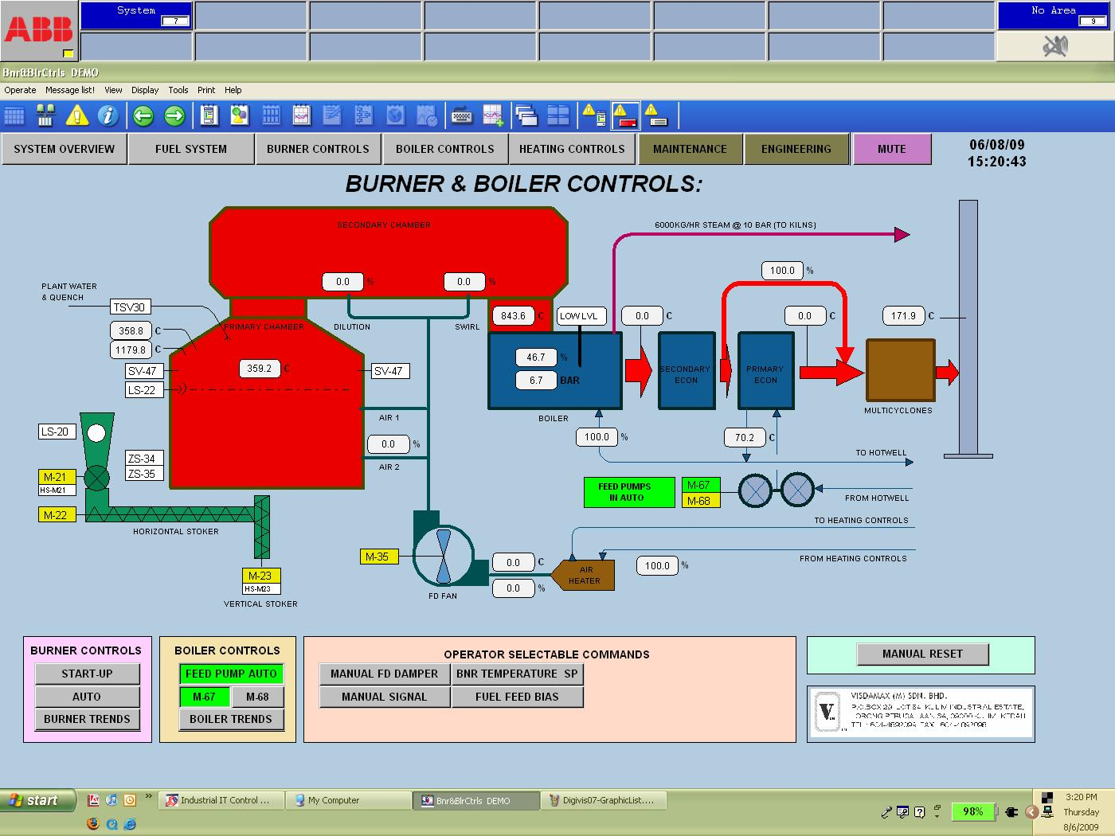
Systems for modelling and simulation

Slide 17
Software Engineering: The Fundamental Principles
Some fundamental principles apply to all types of software system, irrespective of the development techniques used:
Systems should be developed using a managed and understood development process. Of course, different processes are used for different types of software.
Dependability and performance are important for all types of system.
Understanding and managing the software specification and requirements (what the software should do) are important.
Where appropriate, you should reuse software that has already been developed rather than write new software.

Slide 18
Software engineering and the web
The Web is now a platform for running application and organizations are increasingly developing web-based systems rather than local systems.
Web services allow application functionality to be accessed over the web.
Cloud computing is an approach to the provision of computer services where applications run remotely on the ‘cloud’.
Instead of installing a suite of software for each computer, you'd only have to load one application. That application would allow workers to log into a Web-based service which hosts all the programs the user would need for his or her job. Remote machines owned by another company would run everything from e-mail to word processing to complex data analysis programs. It's called cloud computing.
Users do not buy software, pay according to use.

Slide 19
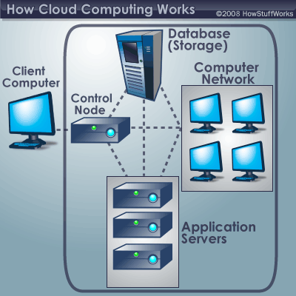
Cloud Computing

Slide 20
Key points
Software engineering is an engineering discipline that is concerned with all aspects of software production.
Essential software product attributes are maintainability, dependability and security, efficiency and acceptability.
The high-level activities of specification, development, validation and evolution are part of all software processes.
The fundamental notions of software engineering are universally applicable to all types of system development.

Slide 21
Key points
There are many different types of system and each requires appropriate software engineering tools and techniques for their development.
The fundamental ideas of software engineering are applicable to all types of software system.

Slide 22
Software engineering Ethics
Software engineering involves wider responsibilities than simply the application of technical skills.
Software engineers must behave in an honest and ethically responsible way if they are to be respected as professionals.
Ethical behaviour is more than simply upholding the law but involves following a set of principles that are morally correct.

Slide 23
Issues of professional responsibility
Confidentiality
Engineers should normally respect the confidentiality of their employers or clients irrespective of whether or not a formal confidentiality agreement has been signed.
Competence
Engineers should not misrepresent their level of competence. They should not knowingly accept work which is out with their competence.

Slide 24
Issues of professional responsibility
Intellectual property rights
Engineers should be aware of local laws governing the use of intellectual property such as patents, copyright, etc. They should be careful to ensure that the intellectual property of employers and clients is protected.
Computer misuse
Software engineers should not use their technical skills to misuse other people’s computers. Computer misuse ranges from relatively trivial (game playing on an employer’s machine, say) to extremely serious (dissemination of viruses).

Slide 25
Case studies
A personal insulin pump
An embedded system in an insulin pump used by diabetics to maintain blood glucose control.
A mental health case patient management system
An information system used to maintain records of people receiving care for mental health problems.
A wilderness weather station
A data collection system that collects data about weather conditions in remote areas.

Slide 26
Insulin pump control system
Collects data from a blood sugar sensor and calculates the amount of insulin required to be injected.
Calculation based on the rate of change of blood sugar levels.
Sends signals to a micro-pump to deliver the correct dose of insulin.
Safety-critical system as low blood sugars can lead to brain malfunctioning, coma and death; high-blood sugar levels have long-term consequences such as eye and kidney damage.

Slide 27
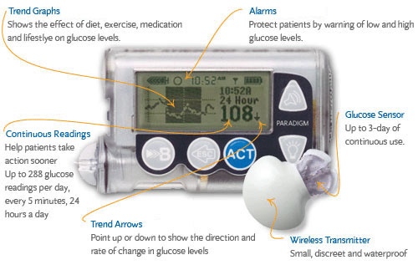
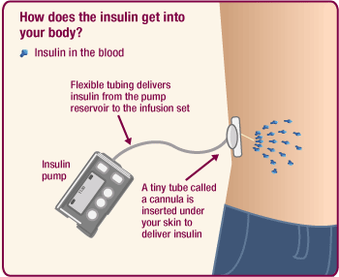

Slide 28
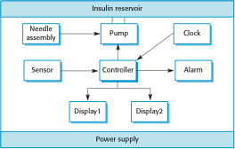
Insulin pump hardware architecture

Slide 29
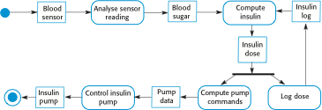
Activity model of the insulin pump

Slide 30
Essential high-level requirements
The system shall be available to deliver insulin when required.
The system shall perform reliably and deliver the correct amount of insulin to counteract the current level of blood sugar.
The system must therefore be designed and implemented to ensure that the system always meets these requirements.

Slide 31
A patient information system for mental health care
A patient information system to support mental health care is a medical information system that maintains information about patients suffering from mental health problems and the treatments that they have received.
Most mental health patients do not require dedicated hospital treatment but need to attend specialist clinics regularly where they can meet a doctor who has detailed knowledge of their problems.
To make it easier for patients to attend, these clinics are not just run in hospitals. They may also be held in local medical practices or community centres.

Slide 32
MHC-PMS
The MHC-PMS (Mental Health Care-Patient Management System) is an information system that is intended for use in clinics.
It makes use of a centralized database of patient information but has also been designed to run on a PC, so that it may be accessed and used from sites that do not have secure network connectivity.
When the local systems have secure network access, they use patient information in the database but they can download and use local copies of patient records when they are disconnected.

Slide 33
MHC-PMS goals
To generate management information that allows health service managers to assess performance against local and government targets.
To provide medical staff with timely information to support the treatment of patients.

Slide 34
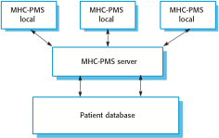
The organization of the MHC-PMS

Slide 35
MHC-PMS key features
Individual care management
Clinicians can create records for patients, edit the information in the system, view patient history, etc. The system supports data summaries so that doctors can quickly learn about the key problems and treatments that have been prescribed.
Patient monitoring
The system monitors the records of patients that are involved in treatment and issues warnings if possible problems are detected.
Administrative reporting
The system generates monthly management reports showing the number of patients treated at each clinic, the number of patients who have entered and left the care system, number of patients sectioned, the drugs prescribed and their costs, etc.

Slide 36
MHC-PMS concerns
Privacy
It is essential that patient information is confidential and is never disclosed to anyone apart from authorised medical staff and the patient themselves.
Safety
Some mental illnesses cause patients to become suicidal or a danger to other people. Wherever possible, the system should warn medical staff about potentially suicidal or dangerous patients.
The system must be available when needed otherwise safety may be compromised and it may be impossible to prescribe the correct medication to patients.

Slide 37
Wilderness weather station
The government of a country with large areas of wilderness decides to deploy several hundred weather stations in remote areas.
Weather stations collect data from a set of instruments that measure temperature and pressure, sunshine, rainfall, wind speed and wind direction.
The weather station includes a number of instruments that measure weather parameters such as the wind speed and direction, the ground and air temperatures, the barometric pressure and the rainfall over a 24-hour period. Each of these instruments is controlled by a software system that takes parameter readings periodically and manages the data collected from the instruments.

Slide 38

The weather station’s environment

Slide 39
Weather information system
The weather station system
This is responsible for collecting weather data, carrying out some initial data processing and transmitting it to the data management system.
The data management and archiving system
This system collects the data from all of the wilderness weather stations, carries out data processing and analysis and archives the data.
The station maintenance system
This system can communicate by satellite with all wilderness weather stations to monitor the health of these systems and provide reports of problems.

Slide 40
A digital learning environment for schools

Slide 41
Additional software functionality###03
Monitor the instruments, power and communication hardware and report faults to the management system.
Manage the system power, ensuring that batteries are charged whenever the environmental conditions permit but also that generators are shut down in potentially damaging weather conditions, such as high wind.
Support dynamic reconfiguration where parts of the software are replaced with new versions and where backup instruments are switched into the system in the event of system failure.

Slide 42
Generic View of Process
During the time of developing we have to go through a series of predictable steps that helps:
Timely Delivery
High quality Result
The steps we follow is called Process.

Slide 43
Layered Technology of Software Engineering
For establish the sound engineering principles we have to ensure the layers of S/W engineering:
Tools
Method
Process
Quality Focus

Slide 44
Layers of Software Engineering
Quality Focus
At first ensure the professional quality
Process
Enable timely delivery through framework and work products(models, docs, report etc.)
Ensure technical method
Ensure the model and change is properly managed
Method
Define “how to” ’s and define broad array of tusks
Include communication, analysis, designing, program construction, testing and support.
Tools
Provide support for the process and method.

Slide 45
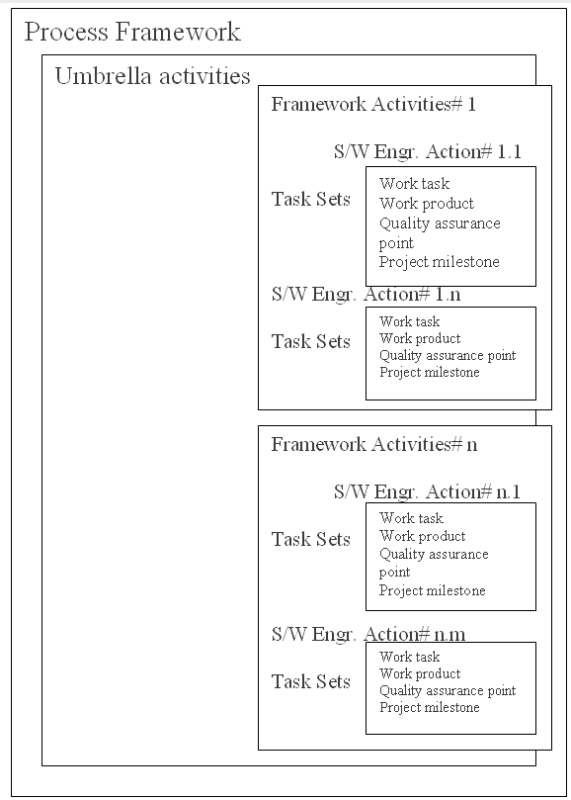
Software Process Framework Activity

Slide 46
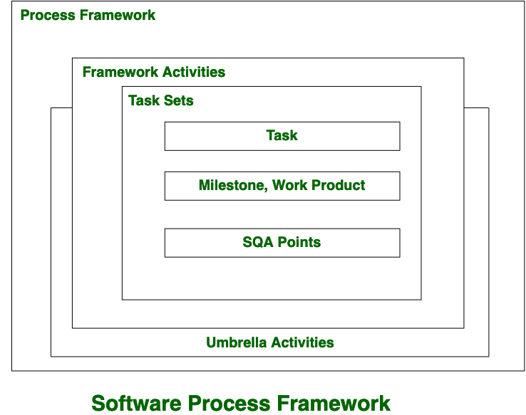

Slide 47
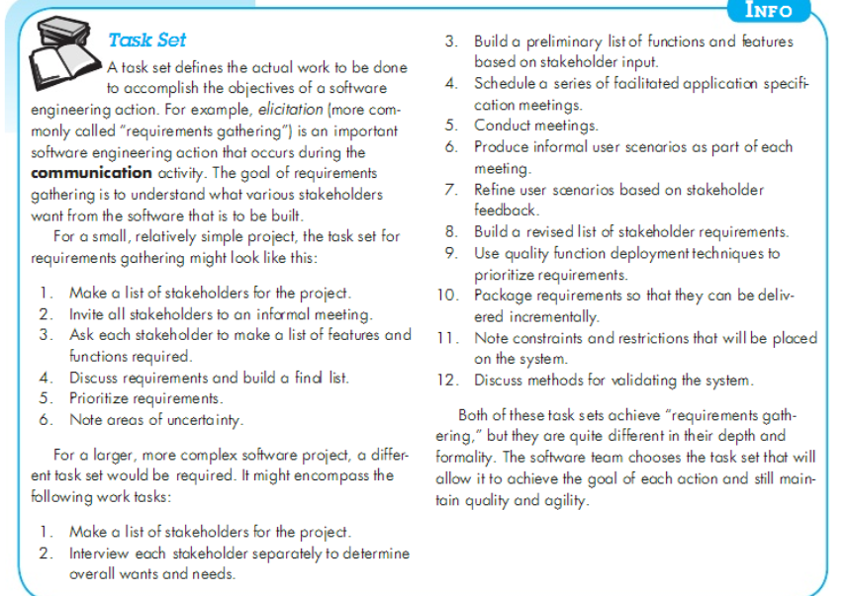

Slide 51
Framework Process
Communication
Planning
Modeling
Construction
Deployment

Slide 52
Umbrella Activities
S/w project tracking and control
Risk management
S/W quality assurance
Formal technical review
Measurement
S/W configuration management
Reusability management
Work product preparation and production

Slide 53
Umbrella activities
Typical umbrella activities are: 1. Software project tracking and controlIn this activity, the developing team accesses project plan and compares it with the predefined schedule.
If these project plans do not match with the predefined schedule, then the required actions are taken to maintain the schedule.
2. Risk managementRisk is an event that may or may not occur.
If the event occurs, then it causes some unwanted outcome. Hence, proper risk management is required.
3. Software Quality Assurance (SQA)SQA is the planned and systematic pattern of activities which are required to give a guarantee of software quality. For example, during the software development meetings are conducted at every stage of development to find out the defects and suggest improvements to produce good quality software.

Slide 54
4. Formal Technical Reviews (FTR)FTR is a meeting conducted by the technical staff.
The motive of the meeting is to detect quality problems and suggest improvements.
The technical person focuses on the quality of the software from the customer point of view.
5. MeasurementMeasurement consists of the effort required to measure the software.
The software cannot be measured directly. It is measured by direct and indirect measures.
Direct measures like cost, lines of code, size of software etc.
Indirect measures such as quality of software which is measured by some other factor. Hence, it is an indirect measure of software.

Slide 55
6. Software Configuration Management (SCM)It manages the effect of change throughout the software process.
7. Reusability managementIt defines the criteria for reuse the product.
The quality of software is good when the components of the software are developed for certain application and are useful for developing other applications.
8. Work product preparation and productionIt consists of the activities that are needed to create the documents, forms, lists, logs and user manuals for developing a software.

Slide 56
Essence of Software Engineering Practice
Understand the problem (communication and analysis)
Plan a solution (modelling and software design)
Carry out the plan (code generation)
Examine the result for accuracy (testing and quality assurance)

Slide 57
General principles
The reason it all exists
KISS!
Maintain the vision
Be open to the future
Plan ahead for reuse
Think!

Slide 58
Key points
Software engineers have responsibilities to the engineering profession and society. They should not simply be concerned with technical issues.
Professional societies publish codes of conduct which set out the standards of behaviour expected of their members.
Process Framework Activities
Three case studies are used in the book:
An embedded insulin pump control system
A system for mental health care patient management
A wilderness weather station

